Slide 1
SQL Advance
Fadly Febriya S.SI., M.Kom

Slide 2
JOIN 3 Table
01

Slide 3

idMovie | idDirector | title | category
A01 | 1 | Kimi No Nawa | Animations
A02 | 1 | No Game no Life | Animations
A03 | 1 | Re-Zero | Animations
B01 | 3 | Human Centipede | Thriller
B02 | 3 | Saw | Thriller
C01 | 2 | Yesterday | Drama
C02 | 3 | The Notebook | Drama
D01 | 2 | Avatar | Scifi
D02 | 2 | The Mist | Scifi
E01 | 1 | Bodyguard | Action
idUser | firstName | lastName | idMovie
1 | Bambang | Agus | D01
2 | Jajang | Nurjaman | B02
3 | Betty | Sukinem | A03
4 | Rinda | Melinda | C02
5 | Robert | Perela | A01
6 | Asep | Sukron | B01
idDirector | firstName | Studio
1 | Takayama Sugurou | Universal Studio Japan
2 | Alex Stallman | Paramount Pictures
3 | Chrissy Felips | Hollywood Picture

Slide 4
SQL JOIN 3 Tabel
SELECT A.`firstName` , A.`lastName` , B.`title`, C.`namaDirector`, C.`Studio`
FROM `user`AS A
INNER JOIN `movie` AS B
ON A.`idMovie` = B.`idMovie`
INNER JOIN `director` AS C
ON B.`idDirector` = C.`idDirector`

Slide 5
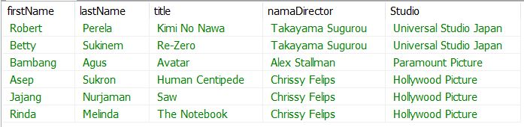
Inner Join 3 Table Output

Slide 6
View
Tujuan dari pembuatan VIEW adalah untuk kenyamanan (mempermudah penulisan query), untuk keamanan (menyembunyikan beberapa kolom yang bersifat rahasia), atau dalam beberapa kasus bisa digunakan untuk mempercepat proses menampilkan data (terutama jika kita akan menjalankan query tersebut secara berulang).

Slide 7
View Query
CREATE VIEW vReportMovie AS
SELECT A.`firstName` , A.`lastName` , B.`title`, C.`namaDirector`, C.`Studio`
FROM `user`AS A
INNER JOIN `movie` AS B
ON A.`idMovie` = B.`idMovie`
INNER JOIN `director` AS C
ON B.`idDirector` = C.`idDirector`

Slide 8
Use View
SELECT * FROM vReportMovie

Slide 9

Untuk Menampilkan View
SHOW FULL TABLES IN bioskop WHERE TABLE_TYPE LIKE 'VIEW';

Slide 10
Triggers
01

Slide 11
Create Trigger
CREATE TRIGGER trackUser
AFTER INSERT ON user
FOR EACH ROW
INSERT INTO log_user
VALUES (default,'Tambah Data', NOW());
END$$

Slide 12
Create Trigger UPDATE
CREATE TRIGGER trackUpdateUser
AFTER UPDATE ON user
FOR EACH ROW
INSERT INTO log_user
VALUES (default,’Update Data', NOW());
END$$

Slide 13
Create Trigger DELETE
CREATE TRIGGER trackDeleteUser
AFTER DELETE ON user
FOR EACH ROW
INSERT INTO log_user
VALUES (default,’Hapus Data', NOW());
END$$

Slide 14

Select * from Log

Slide 15
STORE PROCEDURE
01

Slide 16
Create SP
DELIMITER $$
DROP PROCEDURE IF EXISTS `INSERTDATA`$$
CREATE PROCEDURE `INSERTDATA`(NAMA VARCHAR(50),AKHIR VARCHAR(50),kode CHAR(3))
BEGIN
INSERT INTO user (idUser,FirstName,LastName,idMovie)
VALUES
(DEFAULT,NAMA,AKHIR,kode);
END$$
DELIMITER ;

Slide 17
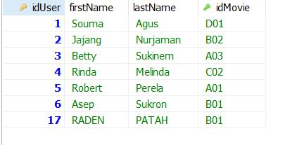
Panggil SP
CALL INSERTDATA('RADEN','PATAH','B01');

